Slide 1
Software Deployment
By
Raúl Mazo
Paola Vallejo

Slide 2
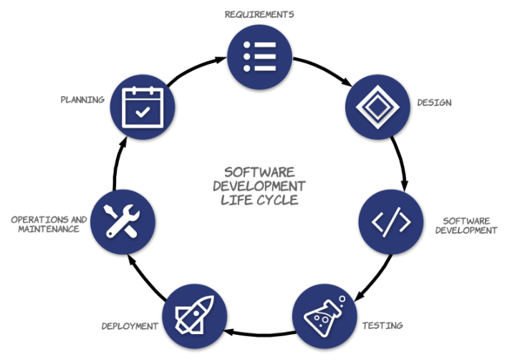
Systems Development Life Cycle (SDLC)
Timeline
Delivery date
Requirements

Slide 3
Software Deployment
All activities that make a software system available for use
Process of coding, testing and fixing bugs to develop a complete application

Slide 4
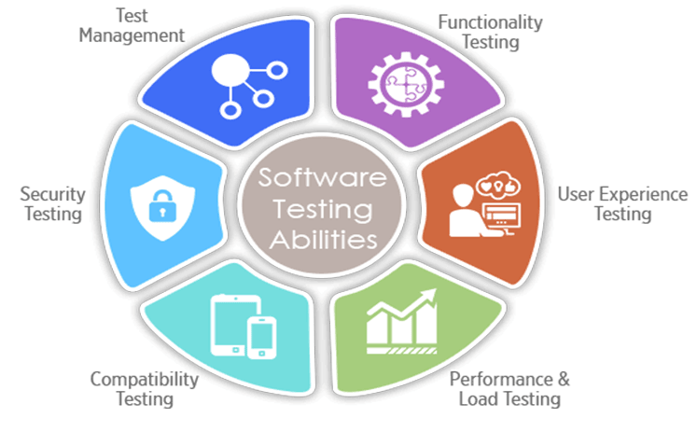
Deployment stages
Development and deployment: deployment method and configuration metrics
Testing
Monitoring: continuity of
deployment actions
Notes:
https://medium.com/@dilshanramesh81/data-persistence-add16cb74cf3

Slide 5
Systems Development Life Cycle (SDLC)
Release

Slide 6
Deployment stages
Plan release: create a workflow that both your team and key stakeholders can refer to throughout a release (and throughout the project)
Build release: develop the product based on the requirements outlined in the release plan
User acceptance testing: users use the product and give feedback
Prepare release: review by the QA team
Deploy release: release the product into the live production environment
Notes:
https://medium.com/@dilshanramesh81/data-persistence-add16cb74cf3

Slide 7
Best deployment practices
Implement a deployment checklist: It helps you to follow what must be done next so that you will not miss out any of the crucial steps
Choose the right deployment method: Implement the software that is easy to integrate with the existing local applications and their tools
Automate software deployment process: It mitigates the possibilities of errors and increases the deployment speed
Adopt continuous delivery: It ensures to enable the code for the required deployment
Adopt continuous integration: It ensured that the developed software works in conjunction with previously development
Use tools: It makes the method of distributing software and updates as simple as possible
Notes:
OLTP: Online transaction processing

Slide 8
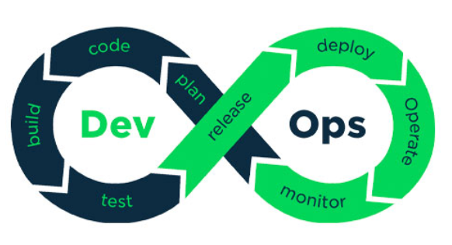
Systems Development Life Cycle (SDLC)
Development
Operation

Slide 9
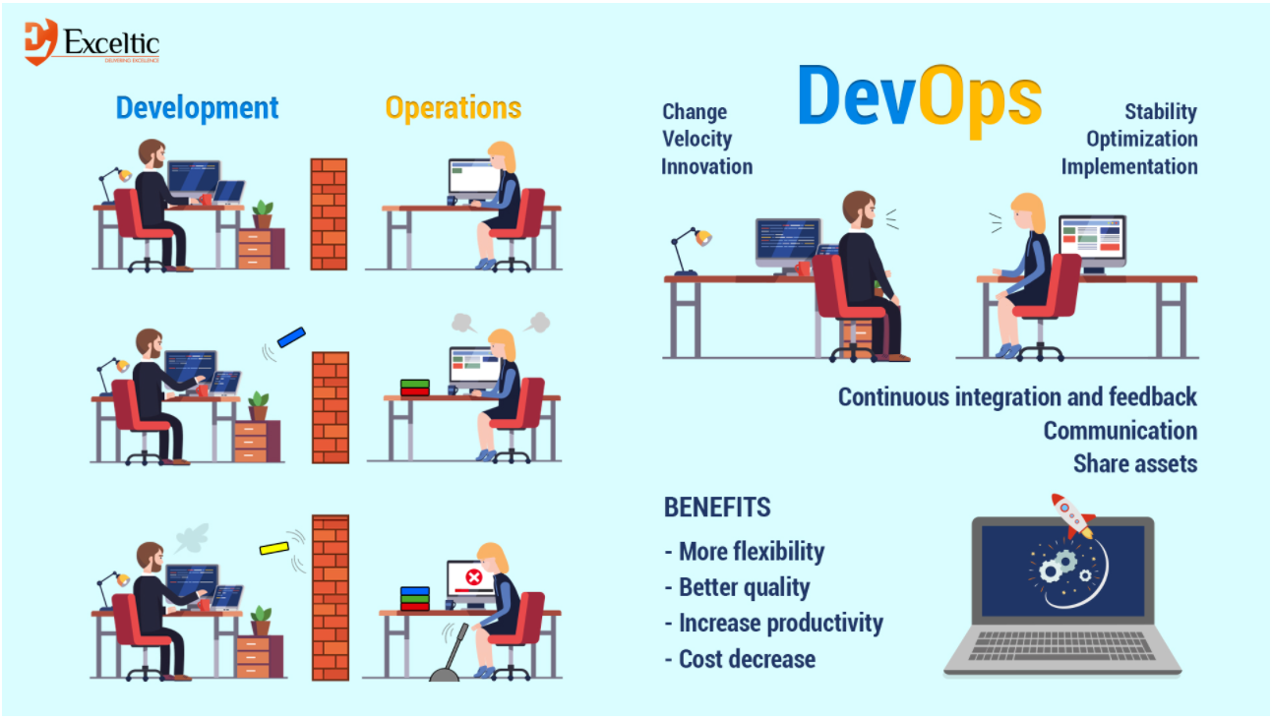
Notes:
Fuente: https://exceltic.com/noticia?id=que-es-devops

Slide 10
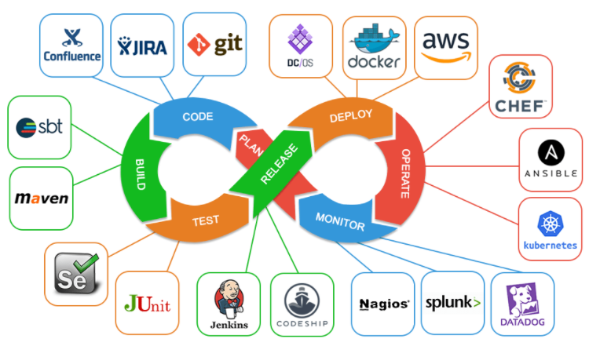
Tools
Jenkins
Docker
AWS
Azure DevOps
GitLab
Travis CI
Bamboo
Notes:
https://kinsta.com/es/blog/herramientas-devops/

Slide 11
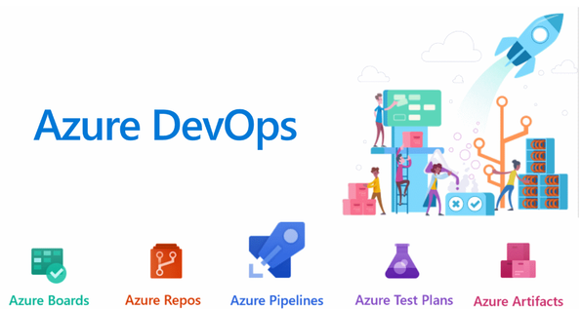
Tools - AzureDevOps
Notes:
https://kinsta.com/es/blog/herramientas-devops/

Slide 12
Tools – AWS
Cloud computing platform to develop and operate web services.
Some of the products are: virtual machines, web hosting, file storage, data processing, management tools.
A virtual machine is a computer emulated on another machine.

Slide 13
Questions ???

